Slide 1
House Valuation Report
A Case Study
-Sujay Danappanavar

Slide 2



AGENDA
This Presentation will analyse the data on house valuations in the USA state and region wise with the goal of providing valuable insights and recommendations for the roofing and insurance industry. We will discuss how house prices impacts both industries within US.
Insurance Industry
Roofing Industry

Slide 3
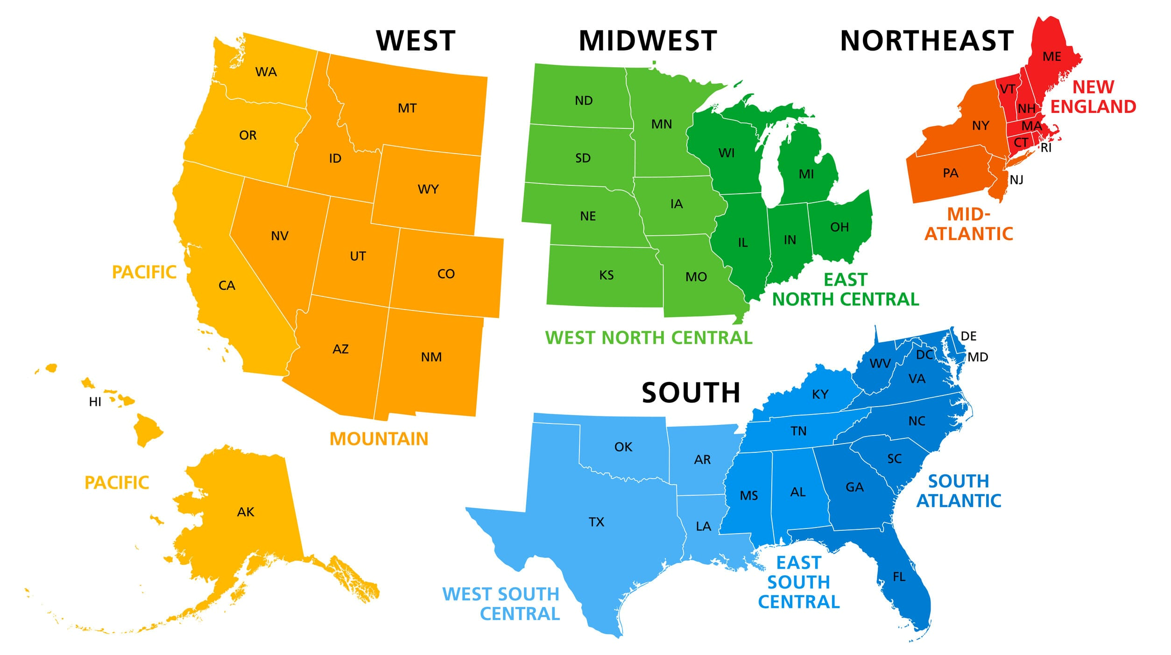
SUMMARY
Region wise and State wise Analysis :
We will analyse the entire US house valuation data to find insights that reflect varying house prices by state and regional real estate markets. This will help roofing and insurance industries to make informed decisions with complete knowledge of current trends and house values in different regions.
Regions Segregated
West Mid-West North East South

Slide 4







METHODOLOGY
.
Problem Definition
Data
Collection
Data
Processing
Exploratory
Analysis
Data
Visualization
Insights /
Suggestions
Problem
Definition
1
1
2
3
4
5
6
To assess how House values trends change throughout the nation. Determine the effectiveness of the same on the roofing and insurance industries based price and other key factors.
Raw data was extracted from open source online websites after exploring many sites, supporting small data required were extracted manually from google. The datasets were saved locally.
Raw data was processed and cleaned in MS Excel. Many duplicate records were filtered out, addressed missing and inconsistent data, filtered the dataset to get a clean dataset.
Prepared data was then analysed and new measures and variables were created. Ideated the Region wise grouping of states for better understanding of price distribution and trends in different regions.
Beautiful and interactive Dashboards were built using Power Bi. Charts and Map visuals were created including slicers and filters for better understand of trends through different regions and states.
Multiple insights and key findings were reported. Based on the Power Bi report, list of advices and strategies were discussed with the stakeholders to drive informed decision making.

Slide 5
DATA EXPLORATION
House Prices were averaged based on cities and states to perform comparative analysis.
Distribution of house prices throughout the country were indicated in different Map visuals along with charts for clear and distinct understanding.
Enhanced the model by Grouping the states into four Regions naming West, Mid-West, North East, South for better understanding of trends.
Key Findings were then related with many other factors like location, geographical elements, etc.

Slide 6
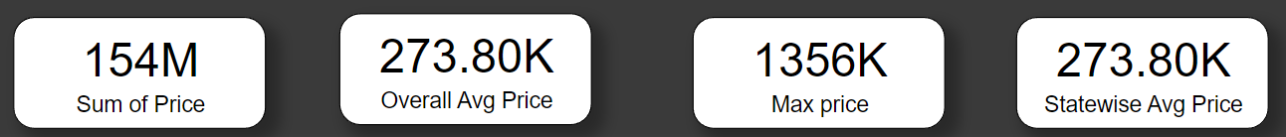
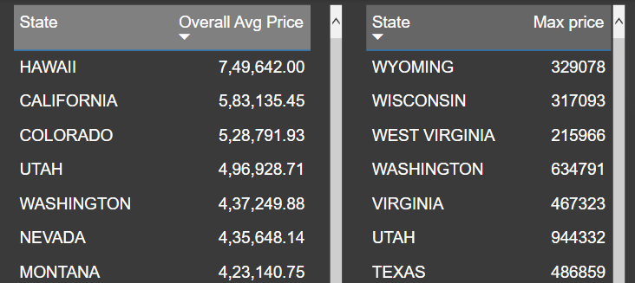
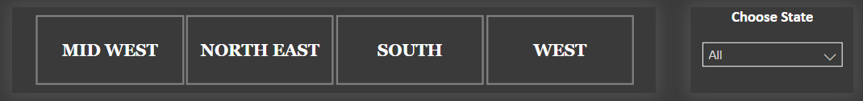
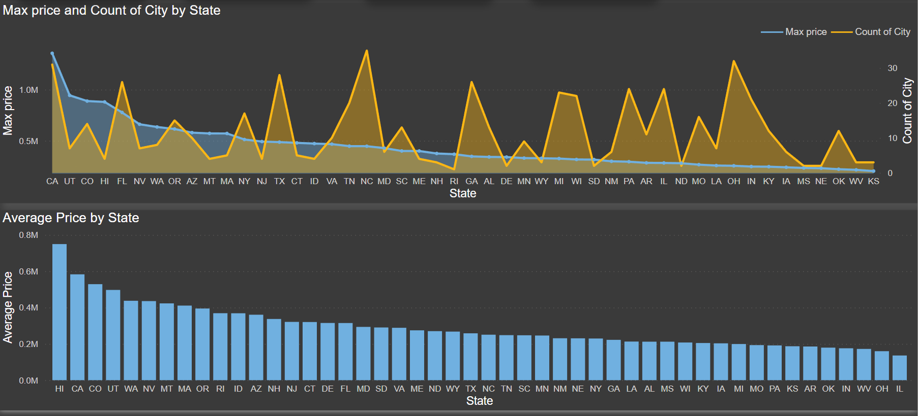
DATA VISUALIZATION
Cards :
Tables :
Slicers :
Charts :

Slide 7
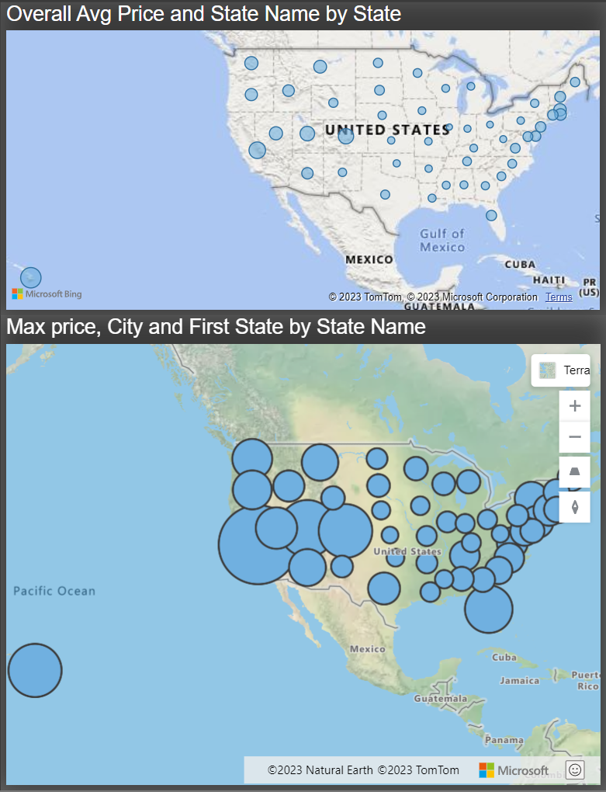
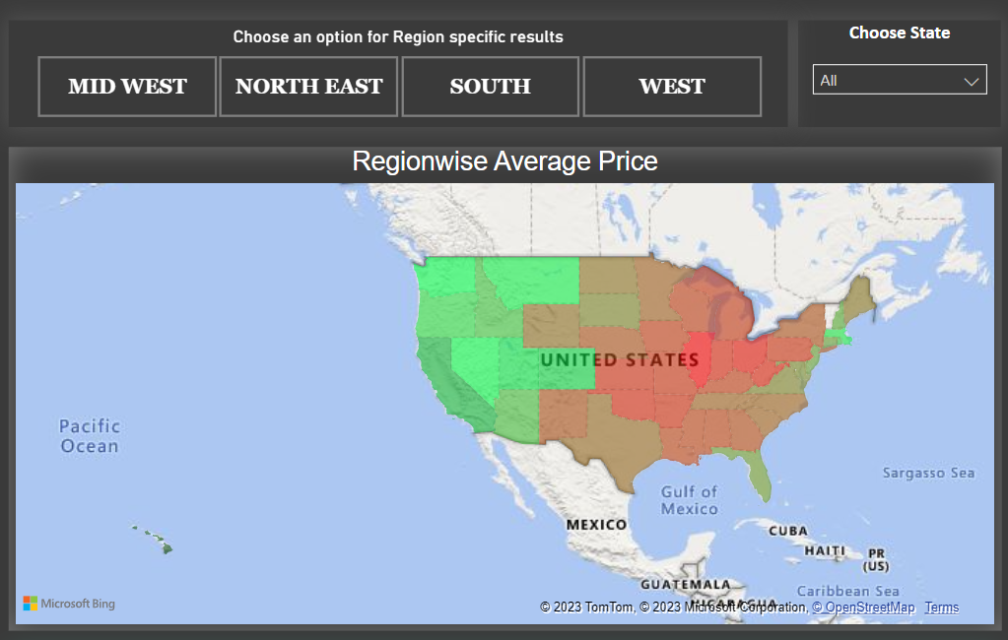
MAP VISUALS
Map -1 :
Map -2 :
Map-1 , Data being showcased in a understandable manner to everyone by incorporating different map visuals and factors with Spatial Clustering and Regional Disparities.
Map-2, the data was conditionally formatted to show price variations throughout states, green indicating high prices, yellow to medium and Red as low prices.
Region and state slicers to better understand a specific location.

Slide 8
RESULTS
INSIGHTS :
West Region as depicted above has a Highest Average House Price at $472K followed by North East at $252K, South at $244K and at the lowest is the Mid West at $184K.
California stands at the second highest average house price at $583K due reasons it being a booming tech industry, warm climate, and stunning coastline. California state even had a highest individual house price of $1.3 Million located at San Jose City.
STRATEGIES
Roofing Industry may charge more for their service in Hawaii state as the transportation and higher goods storage cost and many miscellaneous costs to the company due to very high living costs in Hawaii.
Roofing industry can attain more customers in Mid-West region by giving competitive price plans to attract more potential customers and even has lesser transportation and storage hassles as their physical network is strong in this region.
At $750K Hawaii state of west region had the highest Overall Avg Price and was 451 % higher than Illinois state, which had the lowest Overall Average Price at $136K.
Hawaii is the state with Highest Average House price at $750K which is justified for its beautiful beaches, warm climate, and breath taking scenery it being an island.
Insurance companies may restructure their insurance plans to West region as Home Value Index is the highest in WEST and this region has higher commercial places which usually has parapet roofs resulting in higher cost and maintenance thus justifying higher insurance packages.
Roofing and Insurance both stakeholders can attain more revenue by restructuring their plans in coastal areas where the roofs are generally similar designs and less roof area, so are not very complex to build and maintain and hence can cache in with the same reasons as they have higher margins

Slide 9
CONCLUSION
LIMITATIONS :
This case study report scratched only the surface of a complex project as this case study gives insights about prices distribution only based on location and regions.
The database is a locally stored data from an open source and real time data is not listed and considered for analysis, but for a case study, the present database gives a accurate and precise overview.
This report is made to foster both insurance and roofing industries at once, methods like incorporating row level security or making two separate reports could make both clients understand the results in a specific vision.
FUTURE SCOPE :
Similar analysis can be done with factors like House Sizes (Area), Roofing material, Roof area, neighboring locality, etc, which can provide a more comprehensive view of the factors influencing house prices.
We can incorporate data from additional sources such as real estate listings, property tax data, or census data to enrich the analysis and provide a more comprehensive view of the housing market making insurance and roofing industries understand the market in more deeper manner.
Explore the use of machine learning algorithms to automate data preprocessing, feature engineering, or predictive modeling tasks, improving the efficiency and accuracy of the analysis.

Slide 10
THANK YOU

